Slide 1
Instructions for use
This deck and its contents are intended for partners and the field.
For questions or more information, please contact Kelly O’Connor.

Slide 2


Technical overview Azure Database for MySQL
August 2022

Slide 3
Agenda
Overview
Common use cases
Performance and scale
Security and compliance
Manageability, monitoring, and tuning
High availability and business continuity
Migration
Reference architectures
Documentation and resources

Slide 4
Overview

Slide 5
Azure builds on the core benefits of MySQL
Security
Intelligent performance
Compliance
Global reach
Web apps
LAMP stack apps
Azure Database for MySQL is a fully managed, intelligent, and scalable MySQL offering
Gaming and mobile apps
eCommerce apps
Scale up and out
Extension support
Built-in HA
Easy ecosystem integration
Notes:
Azure Database for MySQL is a fully managed, intelligent, and scalable MySQL offering with:
Security
Global reach
Extension support
Easy ecosystem integration
Built-in HA
Scale up and out
Compliance
Intelligent performance
The service supports building a wide variety of applications, such as:
LAMP stack apps
eCommerce apps
Gaming and mobile apps
Web apps

Slide 6





Build leading apps on Azure Database for MySQL
Cost effective, fully managed MySQL database
Easy to provision and scale
Build resilient and responsive mission critical applications
Develop and deploy applications faster with the power of Azure
Build on a trusted platform
Fully managed MySQL database with a 48% lower total cost¹ of ownership than on-premises deployments
Provision a database in less than 2 minutes. Easily scale your database with AI powered database monitoring
Optimize your application with query insights and performance tuning recommendations for your mission critical workloads.
Tap into the power of Azure by integrating with Azure Cognitive Services, Azure Kubernetes Service, or Azure App Service.
Deliver data-powered experiences with the security and privacy controls required to innovate with confidence.
The Economic Value of Migrating and Modernizing On-premises Instances to Azure Database for MySQL (https://aka.ms/MySQLFlexibleTCO)
Notes:
Azure Database for MySQL is a cost effective, fully managed MySQL database service in Azure which is easy to provision and scale. Customers and developers can focus on application development instead of managing the infrastructure, operating system, MySQL software, and so on.
Azure Database for MySQL works with PHP, Java, Python, Node.JS, Ruby, .NET, and applications can be hosted in Azure App Service, Azure Kubernetes Service, and Spring Cloud. There is also a great integration to other Azure services, including the end-to-end data platform and the AI services such as Cognitive Services which all can be used when building innovative, intelligent solutions.
Customers and developers will be able to build and deploy their data centric applications with the security and privacy controls required to innovate with confidence
¹ - aka.ms/mysqlflexibletco

Slide 7
The benefits of Azure Database for MySQL
Build or migrate your workloads with confidence and optimized for value
Open-source freedom with ecosystem of extensions
Simplified developer experience
Advanced data security and compliance
Highly available and flexible MySQL
Enjoy a fully compatible MySQL database with support for latest versions. Use your favorite MySQL extensions and Microsoft’s open-source resources.
Increase productivity with a simplified, end-to-end deployment experience at low cost of ownership. Reduce time to market with Azure Kubernetes Service, Azure App Service, and more.
Protect your data with enterprise-grade security and compliance, as well as the enhanced security capabilities of Microsoft Defender for Cloud* and double encryption.
Focus on application innovation with a fully managed, highly available MySQL database service that provides maximum flexibility.
*Available in Single Server; coming soon to Flexible Server.
Notes:
Open-source freedom with ecosystem of extensions - Enjoy a fully compatible MySQL database with support for latest versions. Use your favorite MySQL extensions and Microsoft’s open-source resources.
Simplified developer experience - Increase productivity with a simplified, end-to-end deployment experience at low cost of ownership. Reduce time to market with Azure Kubernetes Service, Azure App Service, and more.
Advanced data security and compliance - Protect your data with enterprise-grade security and compliance, as well as the enhanced security capabilities of Microsoft Defender for Cloud* and double encryption. (*Available in Single Server; coming soon to Flexible Server)
Highly available and flexible MySQL - Focus on application innovation with a fully managed, highly available MySQL database service that provides maximum flexibility.

Slide 8
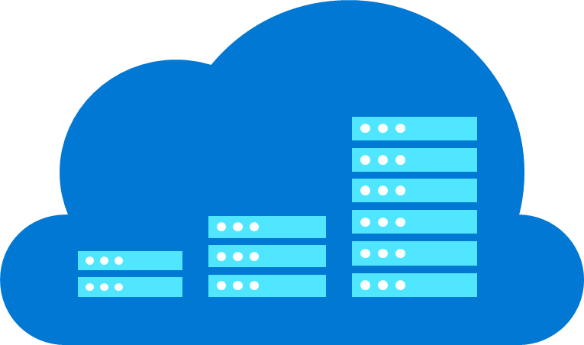
Easy to build with a fully managed service on Azure
Automatic updates
Scale in seconds
Built-in compliance and security
Azure IP Advantage
Azure ensures your data is available and automatically updates your database, freeing you to focus on your application.
Scale your compute or storage resources independently to meet your application’s requirements.
Automatically leverage enterprise-grade security and compliance; proactively receive security alerts with Advanced Threat Protection.
Rest assured that you have best-in-industry uncapped defense and indemnification coverage.
Notes:
Automatic updates – Azure ensures your data is available and automatically updates your database, freeing you to focus on your application.
Scale in seconds - Scale your compute or storage resources independently to meet your application’s requirements.
Built-in compliance and security - Automatically leverage enterprise-grade security and compliance; proactively receive security alerts with Advanced Threat Protection.
Azure IP Advantage - Rest assured that you have best-in-industry uncapped defense and indemnification coverage.

Slide 9

Maximum control and flexibility to meet your workload needs with Flexible Server
Maximum control for your databases
Build resilient apps across availability zones
Simplified developer experience
Control planned downtime with custom maintenance windows
Network isolation with VNet integration and network security groups
Multiple configuration parameters for fine grained database optimization and tuning
Ensure data is always available with zone redundant high availability
Zero data loss within single and multiple availability zones
Guided developer experience increases productivity and simplifies end-to-end deployment
Full compatibility with community edition MySQL
Stop/Start and burstable capabilities for cost optimization
Notes:
Maximum control over your databases –
Network isolation with VNET integration
More server parameters for fine-grained tuning
Custom maintenance windows
App resiliency across availability zones –
Redundant deployment for HA
Fast failover with zero data loss
Co-locate app and database in same zone
Simplified developer experience –
Simple end-to-end deployment
Fully compatible with community MySQL
Easy cost optimization with Stop/Start and Burstable servers

Slide 10




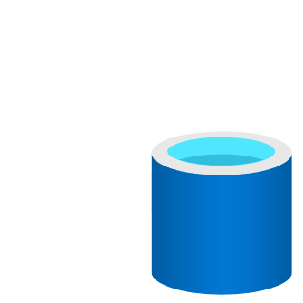
Azure Database for MySQL - Flexible Server Architecture
Region – East US
North Europe
West US 2
Availability Zone 1
Availability Zone 2
Flexible Server
AZ1
AZ2
Linux VM
AZ3
Azure VM
1
4
Availability Zone 3
AKS
Premium Storage
1
Linux VM
2
2
Premium storage with data resiliency (3 copies)
Data, Logs
App Service
3
Zone-redundant backup storage
3
Local/Zone/Geo-redundant backup storage
4
AZ co-location with applications
Notes:
In Azure Database for MySQL – Flexible Server architecture, we have separated compute and storage to provide high availability. Your MySQL server runs on a Linux VM with data stored on premium files storage. The data is replicated 3 times across the storage for better resiliency. You can further opt-in for a same-zone or zone redundant hot standby for high availability. In high availability configuration, the data is synchronously replicated to support zero data loss and automatic failover. The failover typically completes in 60 seconds and you are expected to have a retry logic in your application with connect timeout setting set to > 60 seconds. Flexible Server architecture is zone aware which means you can define the zone where you want your primary server to be hosted. This helps in collocation of application and database server to minimize query latency. The database is automatically backed up and stored on a local redundant storage by default but optionally, can be stored on zone redundant or geo-redundant storage for data protection and disaster recovery. You can deploy your app on VMs, VMSS, AKS or App service and since the service runs open-source community version of MySQL so you don’t need any application refactoring or additional drivers to run with Azure Database for MySQL, the mysql community drivers just works !!!

Slide 11
Common use cases

Slide 12





Top use cases for Azure Database for MySQL Flexible Server
Web apps using popular CMS
Build enterprise web apps using packaged apps such as Alfresco
Build Linux web apps quickly with Azure Database for MySQL and Azure App Service using WordPress and Drupal
Ecommerce platforms
Develop ecommerce applications including popular packaged such as Magento, Shopify
Gaming
Leverage high scale and reliability to build gaming applications with global scale and reach like Minecraft Realms
Mission critical line of business apps
Secure financial data workflows
Cloud-native apps
Build new custom apps in the cloud with Azure Kubernetes Service and Azure App Service
Notes:
One of the top use cases for Azure Database for MySQL Flexible Server is to build web applications using popular content management systems such as Alfresco, WordPress, Drupal, or Joomla.
Azure App Service is a hosting platform for web applications, REST APIs, and mobile back ends in Azure. App Service adds the power of Azure to your application, and has features for security, load balancing, autoscaling, and automated management. It allows you to host both Linux and Windows web applications, so if you are planning to build a website using WordPress, Drupal, or Joomla as the content management system, you can deploy a new website easily using Azure Marketplace and the deployment templates.
E-commerce is a very popular use case for MySQL, and there are even e-commerce platforms such as Magento, which provides a fast go-to-market experience for those developers and businesses who want to build a multi-channel commerce experience for customers on a single platform. Magento, also known as Adobe Commerce, is written in PHP, and can be easily deployed to Azure Kubernetes Service using Azure Marketplace and the pre-packaged container images. Conforming to security standards, such as PCI-DSS is very important in e-commerce, and these types of applications benefit from the security features we have in Azure, such as private networks, data encryption, Azure Firewall, Microsoft Sentinel, Microsoft Defender for Cloud, and so on.
Gaming is a very typical use case for Azure Database for MySQL and customers like Gamepub and Minecraft Realms keep their gamers happy with their fast and reliable database infrastructure and gaming platform in Azure.
Gamepub uses Azure Database for MySQL Flexible Server to have increased control and flexibility of database server parameters, more options for high availability, and cost optimization controls. With Flexible server they can reduce service downtime by aligning server maintenance with the game maintenance schedule.
Minecraft offers both single player and multiplayer modes of gameplay. Minecraft Realms enables players to create personal multiplayer servers, providing a private online multiplayer experience. Originally, Realms was completely hosted on AWS. This included the cloud-hosted multiplayer gamer servers, world state data storage, subscription and metadata databases, and the service code’s compute fabric.
Realms was migrated to Azure Database for MySQL for various reasons: They were looking for cost efficiency by moving from virtual servers to a true Platform-as-a-Service solution to shift focus away from managing virtual machines and to be able to spend more time enhancing the customer experience for their product offering. They were also looking for better interoperability with the Microsoft ecosystem, and to improve gameplay through a lower latency experience that could leverage the global footprint of Azure.
After Minecraft Realms moved its databases, compute, and storage to Azure, they achieved core tactical improvements for the business, including better cost efficiency and service maintainability while improving both the productivity of their developers and the gameplay experience.
Many financial companies and banks are using Azure Database for MySQL for payment and banking applications. A great example is HSBC, one of the world’s largest international banks, who combined the convenience afforded by smart phones with cloud services to allow cashless transactions where people can use their smart phone to perform payments digitally. Today, over one and a half million people use their PayMe app to exchange money with people in their personal network for free. And businesses are using HSBC’s new PayMe for Business app, built natively on Azure, to collect payments instantly, with 98 percent of all transactions completed in less than 500 milliseconds.
They use Azure Database for MySQL, a microservices architecture, and Azure services such as Azure Kubernetes Service, Azure Event Hubs, Azure Storage, Azure Cosmos DB, and Azure Databricks to build a full end-to-end solution.

Slide 13















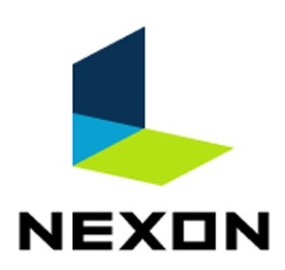


Azure Database for MySQL use cases by industry
Gaming
LMS
IT/Telecom
Healthcare
Banking
Web & CMS
E-commerce
Mobile or desktop gaming apps
Moodle app
E-learning app
Billing / payment app
Health benefit app
Claims processing
Mobile banking app
Digital transaction apps
ECM or CRM apps
WordPress
Retail
Transactional apps
Magento app

Slide 14
Performance and scale
Use Cases

Slide 15
Performance tiers
Compute Tier
Burstable
General Purpose
Business Critical
Target Workloads
Best for workloads that don’t continuously need the full CPU.
Example: An office check-in/out application, which only needs CPU bursts during business hours.
Best for most business workloads that require balanced compute and memory with scalable I/O throughput.
Example: Hosting web and mobile apps and other enterprise applications.
Best for high-performance tier 1 database workloads that require in-memory performance and low disk latency for faster transaction processing and higher concurrency.
Example: Processing real-time data and high-performance transactional or analytical apps.
VM series
vCores
Memory per vCore
Storage size
Max IOPS
B-series
1, 2
Variable
20 GiB to 16 TiB
5000
Ddsv4-series
2, 4, 8, 16, 32, 48, 64
4 GiB
20 GiB to 16 TiB
20000
Edsv4-series
2, 4, 8, 16, 32, 48, 64, 80, 96 (104vcores – coming soon)
8 GiB
20 GiB to 16 TiB (100TiB – coming soon)
80000
Notes:
The compute tiers are differentiated by the underlying VM SKU used B-series, D-series, and E-series. The choice of compute tier and size determines the memory and vCores available on the server. The same storage technology is used across all compute tiers. All resources are provisioned at the MySQL server level. A server can have one or many databases.
Target workloads
Best for workloads that don’t need the full CPU continuously.
Best for most business workloads that require balanced compute and memory with scalable I/O throughput. Examples include servers for hosting web and `mobile apps and other enterprise applications.
Best for high-performance tier 1 database workloads that require in-memory performance and low disk latency for faster transaction processing and higher concurrency. Examples include servers for processing real-time data and high-performance transactional or analytical apps.
Compute tier
Burstable
General Purpose
Business Critical

Slide 16
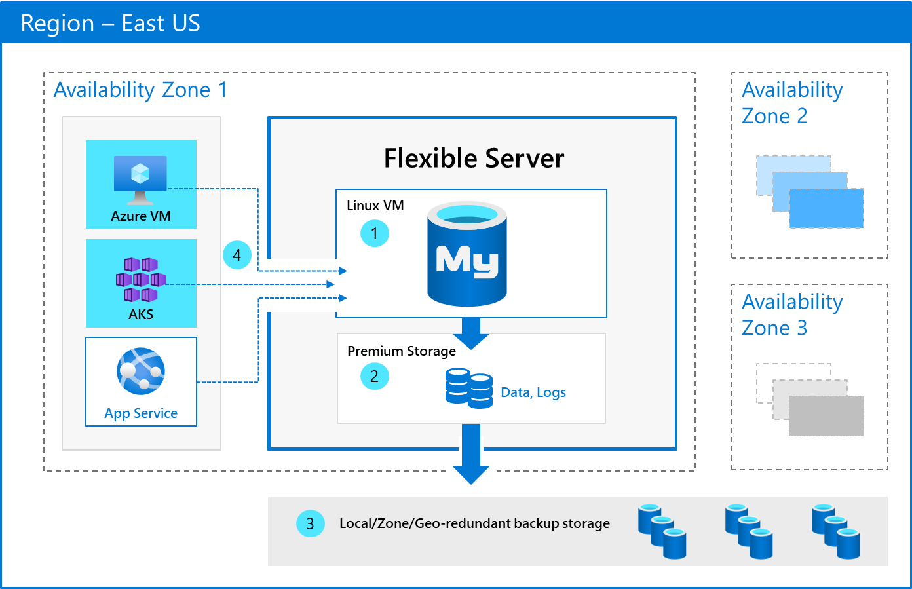
Zone collocated service that offers significantly reduced latency
Greater control over server parameters
Achieve up to a 50% performance boost in Azure Database for MySQL – Flexible Server using thread pools
Notes:
Azure Database for Flexible server offers colocation between compute and storage by default, users get to choose the zone to deploy the server and may choose to place application and database server in the same zone which reduces network latency significantly.
Azure Database for MySQL – Flexible server offers a much richer set of configurable server parameters which enable users to tune the server depending on their workload.
Thread pool allows you to support higher connections, extract more throughput, and overcommit the number of vCores available on the server to maximize performance, assuming the server has enough memory. A thread pool, which is a server-side feature distinct from connection pooling, maximizes performance by introducing a dynamic pool of worker threads that limit the number of active threads running on the server, minimizing thread churn. Instead of creating a new thread for each new connection, a thread pool assigns one of the threads from the pool to handle the request and then returns the connection to the pool after the operation is completed. This helps to ensure that a burst of connections won't cause the server to run out of resources or crash with an out of memory error.

Slide 17
Read replicas to scale out workloads
Asynchronously replicate data from an Azure Database for MySQL server to as many as ten read-only servers (replicas).
Use cases
Help improve the performance and scale of read-intensive workloads.
Read workloads -> Replicas
Write workloads -> Source
Scale an application’s read-workloads using a lightweight connection proxy such as ProxySQL or a microservices-based pattern.
Use read replicas as data source for BI or analytical reporting.
Use for IoT or manufacturing scenarios in which:
Telemetry -> ingested to source
Reporting -> multiple read replicas
Read replica #1
Primary Server
Read replica #2
Read replica #3
Notes:
The read replica feature allows you to replicate data from an Azure Database for MySQL flexible server to a read-only server.
Replicas are updated asynchronously using the MySQL engine's native binary log (binlog) file position-based replication technology.

Slide 18

Read replicas
Available only for the General Purpose or Business Critical pricing tiers.
Replicas are new servers that you manage just like your source MySQL flexible server. Replicas are created with the same server configuration as the source, though you can change the configuration after server creation.
You incur billing charges for each read replica based on the provisioned compute in vCores and storage in GB/month.
Monitor and set alerts for the Replication lag in seconds metric in Azure Monitor.
In case of a disaster when your source server is unavailable, you can direct your workload to a replica in another region after stopping replication.
Notes:
The read replica feature allows you to replicate data from an Azure Database for MySQL flexible server to a read-only server. You can replicate from the source server to up to 10 replicas. Replicas are updated asynchronously using the MySQL engine's native binary log (binlog) file position-based replication technology. To learn more about binlog replication, see the MySQL binlog replication overview.
Replicas are new servers that you manage similar to your source Azure Database for MySQL flexible servers. You will incur billing charges for each read replica based on the provisioned compute in vCores and storage in GB/ month.
Common use cases for read repicas are:
Scaling read-workloads coming from the application by using lightweight connection proxy like ProxySQL or using microservices-based pattern to scale out your read queries coming from the application to read replicas
BI or analytical reporting workloads can use read replicas as data source for reporting
For IoT or Manufacturing scenario where telemetry information is ingested into MySQL database engine while multiple read replicas are use for reporting of data
Because replicas are read-only, they don't directly reduce write-capacity burdens on the source. This feature isn't targeted at write-intensive workloads.
The read replica feature uses MySQL asynchronous replication. The feature isn't meant for synchronous replication scenarios. There will be a measurable delay between the source and the replica. The data on the replica eventually becomes consistent with the data on the source. Use this feature for workloads that can accommodate this delay.

Slide 19
Security and compliance

Slide 20
The safest place for relational data in the cloud​
Authentication and access management
Data protection
Network security
Threat prevention and detection
Azure Active Directory Authentication
SSL/TLS enforcement with TLS v1.3 support
Private access with Network Isolation with VNet Injection and Network Security Groups
Defender for Cloud:
Vulnerability Assessment*
MySQL native password authentication (validate_password, caching_sha2_password plugin support)
Transparent Data Encryption at Rest with Customer Managed Keys
Private Link for MySQL*
Defender for Cloud:
Threat Detection*
Public endpoints with Firewall Rules
Auditing with Multiple Targets
Audit of Microsoft Support Operations
Defender for Cloud: Integration*
*Available in Single Server; coming soon to Flexible Server.
Notes:
Authentication and access management –
Azure Active Directory Authentication
MySQL native password authentication (validate_password, caching_sha2_password plugin support)
Data protection –
SSL/TLS enforcement with TLS v1.3 support
Transparent Data Encryption at Rest with Customer Managed Keys
Network security –
Private access with Network Isolation with VNet Injection and Network Security Groups
Private Link for MySQL*
Public endpoints with Firewall Rules
Threat prevention and detection -
Defender for Cloud: Vulnerability Assessment*
Defender for Cloud: Threat Detection*
Auditing with Multiple Targets
Audit of Microsoft Support Operations
Defender for Cloud: Integration*
*Available in Single Server; coming soon to Flexible Server.

Slide 21
Ensuring the right users have the appropriate access when they need it
Authentication and access management
Azure Active Directory Authentication
Supports token-based authentication for applications connecting to Azure Database for MySQL – Flexible Server
MySQL native password authentication
Native password authentication with support for the validate_password and caching_sha2_password plugins
Simplifies permission management
Provides an alternative to username/password authentication
Helps stop the proliferation of user identities across servers
Allows password rotation and expiration in a single place
Allows additional authentication protections (MFA)
Allows to manage database permissions using external (Azure AD) groups
Can eliminate storing passwords by enabling integrated Windows authentication and other forms of authentication supported by Azure AD
Uses contained users to authenticate identities at the database level
Supports token-based authentication for applications connecting to Azure SQL
Notes:
Authentication and access management –
Azure Active Directory Authentication - Supports token-based authentication for applications connecting to Azure Database for MySQL – Flexible Server
MySQL native password authentication (validate_password, caching_sha2_password plugin support) - Native password authentication with support for the validate_password and caching_sha2_password plugins
Benefits
Simplifies permission management
Provides an alternative to username/password authentication
Helps stop the proliferation of user identities across servers
Allows password rotation and expiration in a single place
Allows additional authentication protections (MFA)
Allows to manage database permissions using external (Azure AD) groups
It can eliminate storing passwords by enabling integrated Windows authentication and other forms of authentication supported by Azure AD
Uses contained users to authenticate identities at the database level
Supports token-based authentication for applications connecting to Azure SQL

Slide 22
Safeguarding your sensitive data
Data protection
Encryption-in-transit
(TLS)
SSL/TLS 1.2 is enforced to keep data secure when being transferred over a network
Encryption-at-rest (TDE)
Encrypt inactive data when stored in database files, backup files, and log files (server-side encryption)​
Notes:
Azure Database for MySQL Flexible Server supports connecting your client applications to the MySQL server using Secure Sockets Layer (SSL) with Transport layer security(TLS) encryption. TLS is an industry standard protocol that ensures encrypted network connections between your database server and client applications, allowing you to adhere to compliance requirements.
Encrypted connectivity using TLS/SSL in Azure Database for MySQL - Flexible Server | Microsoft Docs

Slide 23






Encryption-at-rest TDE with customer-managed keys (BYOK)
Transparent Data Encryption (TDE) protects against the threat of malicious offline activity by encrypting data at-rest
Real-time encryption and decryption without requiring changes to the application
Enables organizations to meet compliance and regulatory requirements, along with defense-in-depth protection
Multiple flexible key management options
Bring-Your-Own-Key (BYOK) stored in Azure Key Vault
Hold-Your-Own-Key (HYOK) in an HSM exclusively managed by the customer
Central key management that allows separation of duties in the management of keys and data
Authentication
Azure Active Directory
Azure Key Vault is a highly available and scalable cloud-based key store
Option to use FIPS 140-2 Level 2 and Level 3 validated hardware security modules (HSMs)
DBA
Wrap/ unwrap DEK
AuditEvent Logging
Azure Key Vault
Azure Monitor
Encryption keys can be generated by the key vault, imported, or transferred to the key vault from an on-premises HSM device
Security
Audit
Notes:
Transparent Data Encryption (TDE) protects against the threat of malicious offline activity by encrypting data at-rest
Real-time encryption and decryption without requiring changes to the application
Enables organizations to meet compliance and regulatory requirements, along with defense-in-depth protection
Multiple flexible key management options
Bring-Your-Own-Key (BYOK) stored in Azure Key Vault
Hold-Your-Own-Key (HYOK) in an HSM exclusively managed by the customer

Slide 24
Network isolation and security
Network security
Private access with Network Isolation with VNET Injection and Network Security Groups
You can deploy your flexible server into your Azure Virtual Network. Azure virtual networks provide private and secure network communication. Resources in a virtual network or a peered network can communicate through private IP addresses. The access to the severs can be controlled with Network Security Groups
Private Link for MySQL*
Private Link allows you to connect to via a private endpoint. Azure Private Link essentially brings Azure services inside your private Virtual Network (VNet). The resources can be accessed using the private IP address just like any other resource in the VNet.
Public endpoints with Firewall Rules
Your flexible server is accessed through a public endpoint. The public endpoint is a publicly resolvable DNS address. The phrase “allowed IP addresses” refers to a range of IPs you choose to give permission to access your server. These permissions are called firewall rules
*Available in Single Server; coming soon to Flexible Server.
Notes:
Network security –
Private access with Network Isolation with VNET Injection and Network Security Groups - You can deploy your flexible server into your Azure Virtual Network. Azure virtual networks provide private and secure network communication. Resources in a virtual network or a peered network can communicate through private IP addresses. The access to the severs can be controlled with Network Security Groups
Private Link for MySQL* - Private Link allows you to connect to via a private endpoint. Azure Private Link essentially brings Azure services inside your private Virtual Network (VNet). The resources can be accessed using the private IP address just like any other resource in the VNet.
Public endpoints with Firewall Rules - Your flexible server is accessed through a public endpoint. The public endpoint is a publicly resolvable DNS address. The phrase “allowed IP addresses” refers to a range of IPs you choose to give permission to access your server. These permissions are called firewall rules.

Slide 25
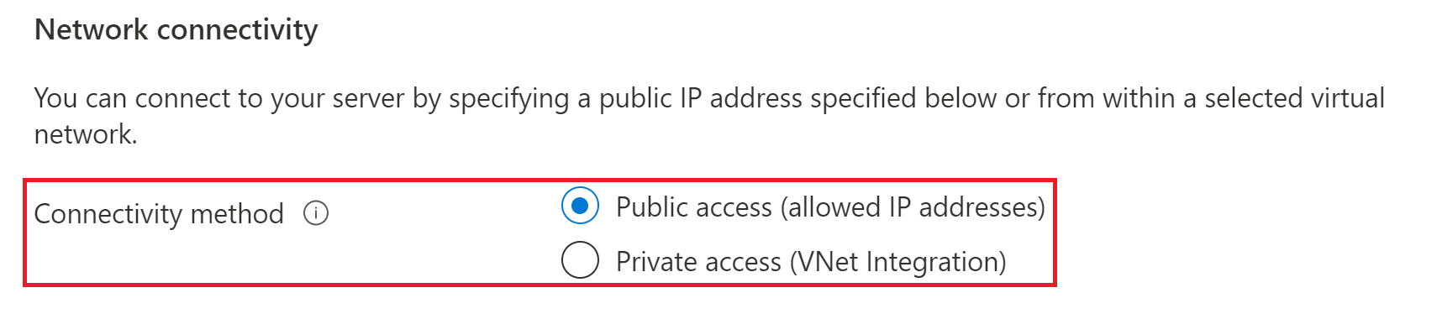

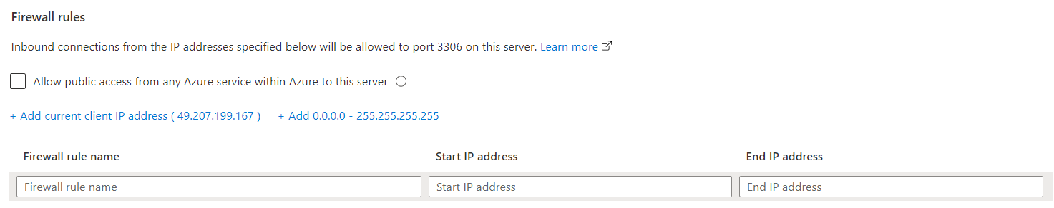

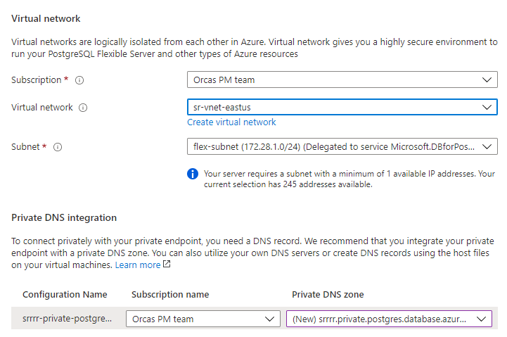
Control network isolation and security
Public access (allowed IP addresses)
Restricted by firewall rules
Add client access list
Private access (VNet integration) Network)
Inject flexible servers to a delegated subnet
Client can be in:
The same VNet
A different VNet in the same region or a different region (VNet peering)
Notes:
Public access (allowed IP addresses)
Restricted by firewall rules
Add client access list
Private access (VNet integration)
Inject flexible servers to a delegated subnet
Client can be in:
The same VNet
A different VNet in the same region or a different region (VNet peering)

Slide 26


Flexible Server Non-HA of Private Network
The architecture shown represents a design pattern in which an application and a MySQL instance are deployed in the same VNet (Customer VNet1).
Azure DB for MySQL – Flexible Server requires a delegated subnet.
For customer connectivity, the “Customer” virtual NIC is injected into the “Delegated” Subnet within the “Customer” VNet.
For Microsoft connectivity, a MSFT virtual NIC is provisioned automatically
Microsoft connectivity to maintain the health of the Azure DB for MySQL – Flexible Server instance
Region – East US
Customer VNet1
AZ-1
MSFT VNet
Flexible Server
Linux VM
Customer
NIC
Azure Storage
AKS
MySQL
MSFT NIC
Delegated Subnet
Management Workflow
Azure Storage
Notes:
Architecture shown represents a design pattern where an application and a MySQL instance are deployed in the same VNet (Customer VNet1)
Azure DB for MySQL – Flexible Server requires delegated Subnet
For customer connectivity, the “Customer” virtual NIC is injected into the “Delegated” Subnet within the “Customer” VNET
For Microsoft connectivity, a MSFT virtual NIC is provisioned automatically
Microsoft connectivity to maintain the health of the Azure DB for MySQL – Flexible Server instance

Slide 27
Flexible Server HA of Private Network
The architecture depicted here represents a design pattern in which an application and a MySQL instance are deployed in the same VNet.
Azure DB for MySQL – Flexible Server requires a delegated subnet.
An Azure DB for MySQL – Flexible Server instance is deployed using HA such that the primary and secondary instances are in different Azure Zones.
The standby server has the same configuration (compute tier, compute size, storage size, and network configuration) as the primary server.
Replication happens between the DB layer and storage layer. The standby pull data from the storage of primary server.
For customer connectivity, the “Customer” virtual NIC is injected into the “Delegated” Subnet within the “Customer” VNet.
For Microsoft connectivity, a MSFT virtual NIC is provisioned automatically.
Microsoft connectivity to maintain the Azure DB for MySQL – Flexible Server instance health.
During the failover, the standby replica is activated and the primary server binary logs continue to apply to the last committed transaction.
DNS is updated to automatically redirect client connections to the new primary when the client reconnects. No action is required at the client end.
Region – East US
Customer VNet1
AZ-1
MSFT VNet
Flexible Server
Linux VM
Customer
NIC
Azure Storage
AKS
MySQL
MSFT NIC
Delegated Subnet
Standby Server
AZ-2
Management Workflow
Linux VM
MySQL
MSFT NIC
Azure Storage
Notes:
Architecture depicted here represents a design pattern where an application and a MySQL instance are deployed in the same vNet.
Azure DB for MySQL – Flexible Server requires delegated subnet.
Azure DB for MySQL – Flexible Server instance is deployed using HA where primary and secondary instances are in different Azure Zone.
The Standby Server has the same configuration as the Primary Server (compute tier, compute size, storage size, and network configuration).
Replication happens between DB layer and storage layer. The standby pull data from the storage of primary server.
For customer connectivity, the “Customer” virtual NIC is injected into the “Delegated” Subnet within the “Customer” VNET
For Microsoft connectivity, a MSFT virtual NIC is provisioned automatically.
Microsoft connectivity to maintain the Azure DB for MySQL – Flexible Server instance health.
During the fail-over, the Standby replica is activated, and the Primary Server binary logs continue to apply to the last committed transaction.
DNS is updated to automatically redirect client connections to the new primary when the client reconnects. No action is required at the client end.

Slide 28
Detect and prevent potential security threats
Threat prevention and detection
Defender for Cloud:
Vulnerability Assessment*
Periodically scan for security misconfiguration and suggest remediation steps. Also provides a security baseline tuned to your environment.
Defender for Cloud:
Threat Detection*
Defender for Cloud provides security alerts on anomalous activities so that you can detect potential threats and respond to them as they occur.
Auditing with Multiple Targets
Ability to enable Audit logs that can be used to track database-level activity including connection, admin, DDL, and DML events. These logs can be piped to LA, Event Hub or Storage using Azure diagnostics settings.
Audit of Microsoft Support Operations
Activity Logs gives you details on activity performed on the service. It helps to determine the what, who, and when for any write operations (PUT, POST, DELETE) that are performed on the resources in your subscription.
Defender for Cloud:
Integration*
Integrated with the Microsoft Defender for Cloud*, which helps to have centralized visibility for all the resources. Unified view to monitor and act on security recommendations
*Available in Single Server; coming soon to Flexible Server.
Notes:
Threat prevention and detection -
Defender for Cloud: Vulnerability Assessment* - Periodically scan for security misconfiguration and suggest remediation steps. Also provides a security baseline tuned to your environment.
Defender for Cloud: Threat Detection* - Defender for Cloud provides security alerts on anomalous activities so that you can detect potential threats and respond to them as they occur.
Auditing with Multiple Targets - Ability to enable Audit logs that can be used to track database-level activity including connection, admin, DDL, and DML events. These logs can be piped to LA, Event Hub or Storage using Azure diagnostics settings.
Audit of Microsoft Support Operations - Activity Logs gives you details on activity performed on the service. It helps to determine the what, who, and when for any write operations (PUT, POST, DELETE) that are performed on the resources in your subscription.
Defender for Cloud: Integration* - Integrated with the Microsoft Defender for Cloud*, which helps to have centralized visibility for all the resources. Unified view to monitor and act on security recommendations
*Available in Single Server; coming soon to Flexible Server.

Slide 29

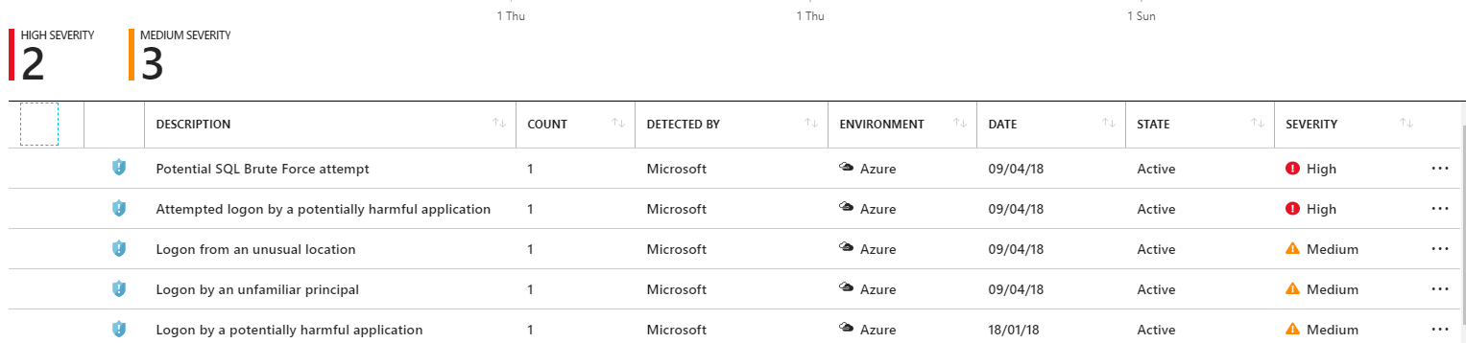
Microsoft Defender for Cloud
Supported on Single Server
Coming to Flexible Server in 2022
Learns from millions of databases
Analysis across all Azure data services world-wide
Uses AI and ML to continuously enhance models
Sends alerts with
Intelligent recommendations
Prescriptive actions
Monitor your servers
Unfamiliar source locations
Brute force attacks
Suspicious users
SQL injection
Detect unusual/harmful attempts to breach your database
Just turn it ON
Detects anomalous access (e.g., brute force, location, app, user…)
Actionable alerts to investigate and remediate
View alerts for your entire Azure tenant using Microsoft Defender for Cloud
Attacker
(2) Possible threat to access / breach data
User
Apps
Azure DB for MySQL
Advanced Threat Protection
Developer
(1) Turn on Advanced Threat Protection
(3) Real-time actionable alerts
Notes:
Learns from millions of databases
Analysis across all Azure data services world-wide
Uses AI and ML to continuously enhance models
Sends alerts with
Intelligent recommendations
Prescriptive actions
Monitor your servers
Unfamiliar source locations
Brute force attacks
Suspicious users
SQL injection
Detect unusual/harmful attempts to breach your database
Just turn it ON
Detects anomalous access (e.g., brute force, location, app, user…)
Actionable alerts to investigate and remediate
View alerts for your entire Azure tenant using Microsoft Defender for Cloud

Slide 30
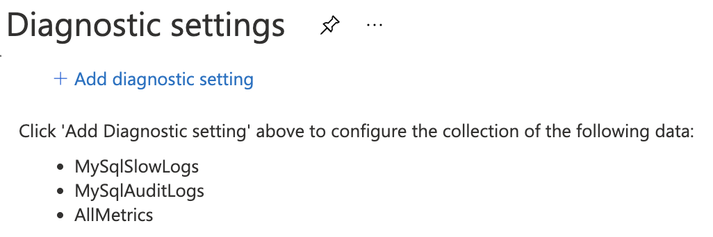

Audit logs
Configure server parameters for audit logging.
Audit Logs
audit_log_enabled, audit_log_events, audit_log_include_users, audit_log_exclude_users, audit_slow_log_enabled
Configure Diagnostics settings to specify the destination for the log files.
Access the data in Azure Monitor.
Notes:
Azure Database for MySQL Flexible Server provides users with the ability to configure audit logs. Audit logs can be used to track database-level activity including connection, admin, DDL, and DML events. These types of logs are commonly used for compliance purposes.
1, 2 & 3 are the steps to configure Audit logs
Audit logs - Azure Database for MySQL - Flexible Server | Microsoft Docs

Slide 31






Industry leading privacy, data residency and compliance
SOC 2
Type 2
Level 1
CSA STAR
Certification
Notes:
Protecting your innovation in the cloud: Reduce risk, innovate with confidence, and operate with freedom in the cloud. Azure IP Advantage provides the industry’s most comprehensive protection against intellectual property (IP) risks.
-Best-in-industry intellectual property protection
-Build confidently with uncapped indemnification
-Deter and defend lawsuits with patent pick
-Get broad protection with a springing license
Based on customer demand from various industry verticals
SOC2 - Service Organization Controls standards for operational security
ISO 27001 - Information Security Management Standards
ISO 27018 - Code of Practice for Protecting Personal Data in the Cloud
CSA STAR - Cloud Security Alliance: Security, Trust & Assurance Registry (STAR)
PCI DSS Level 1 - Payment Card Industry (PCI) Data Security Standard (DSS) Level 1 Service Provider
HIPAA / HITECH Act - Health Insurance Portability and Accountability Act / Health Information Technology for Economic and Clinical Health Act
ISO 27017:2015 - Code of Practice for Information Security Controls
ISO 9001:2015 Quality Management Systems Standards
ISO 22301:2012 Business Continuity Management Standard
ISO/IEC 20000-1:2011 Information Technology Service Management

Slide 32
Manageability, monitoring, and tuning

Slide 33







Options for monitoring databases in Azure
Metrics
Resource health
Logs
Activity logs
Azure Monitor
Workbooks
Alerts
Notes:
Metrics --> Help to view the telemetry information of metrics collected
Logs --> Help to query the logs Audit/slow-query which is send to log analytics workspace
Workbooks --> Help to Visualize data from different data sources like ARM,AGE,Log anlytics,metrices etc in one single pane
Resource health --> Health of the service and dispalys health events
Activity Logs --> Activity Logs give you details on activity performed on the service. It helps to determine the what, who, and when for any write operations (PUT, POST, DELETE) that are performed on the resources in your subscription.
Alerts--> Help you configure and send alert notification when a specific condition is met.

Slide 34
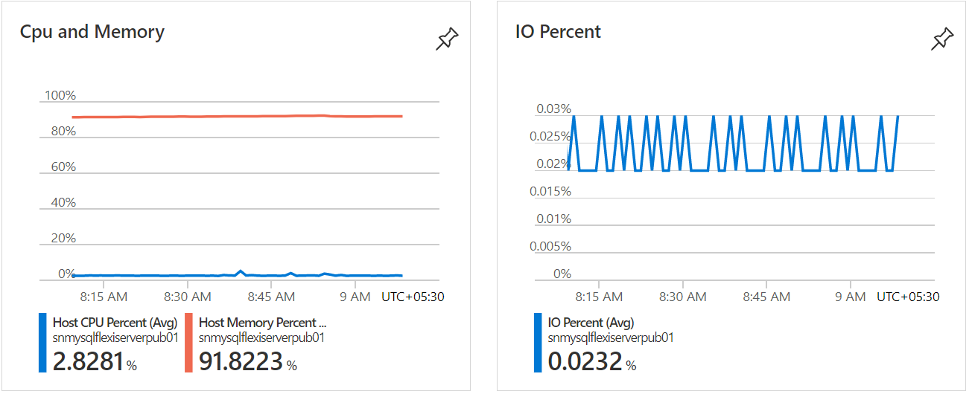
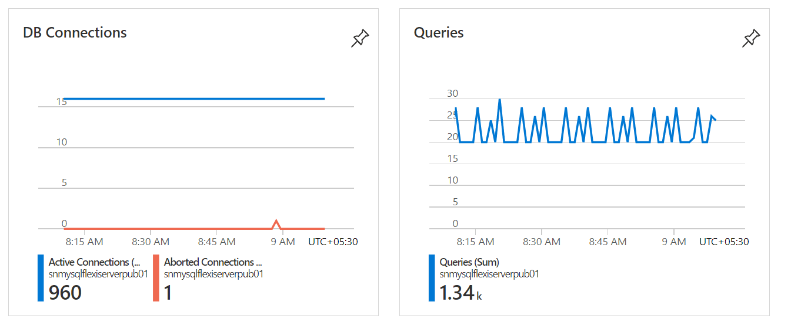
Monitoring - Metrics
Metrics shown on the overview page
See additional details on the metrics page
Traffic
Connection, Query Count etc.
Saturation
CPU, memory, IO Percent, Query count etc.
Errors
Aborted connections
Notes:
Azure Database for MySQL Flexible Server provides monitoring of servers through Azure Monitor. Metrics are numerical values that describe some aspect of the resources of your server at a particular time. Monitoring your server's resources helps you troubleshoot and optimize your workload by allowing you to monitor what matters the most to you. Monitoring the right metrics helps you keep the performance, reliability, and availability of your server and applications.
Monitoring - Azure Database for MySQL - Flexible Server | Microsoft Docs

Slide 35
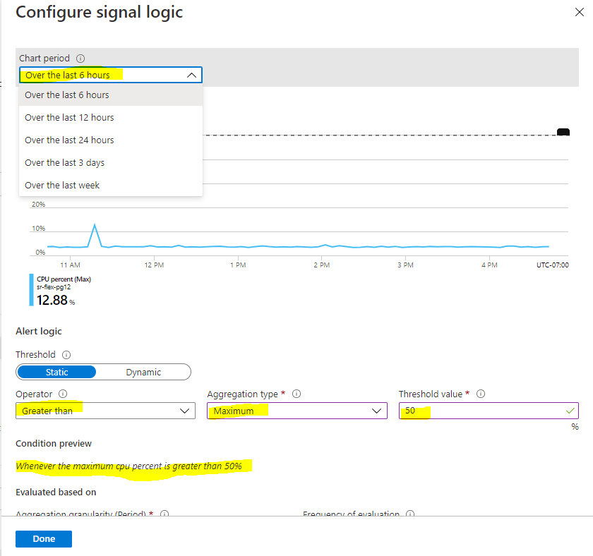
Alerts
Define condition and action
Condition
CPU, storage, memory, IO Percentage, etc.
Example: CPU exceeds %
Action
Create action group
Email/SMS/Push/Voice
Notes:
The alert triggers when the value of a specified metric crosses a threshold you assign. The alert triggers both when the condition is first met, and then afterwards when that condition is no longer being met. Metric alerts are stateful, that is, they only send out notifications when the state changes.
Configure metric alerts - Azure portal - Azure Database for MySQL - Flexible Server | Microsoft Docs

Slide 36
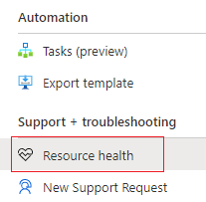
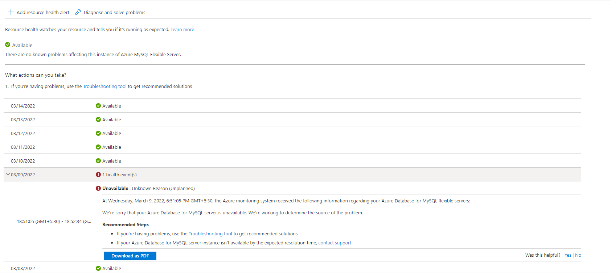
Resource health
Resource health watches your resource and tells you if it's running as expected.
The health of a resource is displayed as one of the following statuses:
Available
Unavailable
Unknown
Degraded
Notes:
Azure Resource Health helps you diagnose and get support for service problems that affect your Azure resources. It reports on the current and past health of your resources.
https://docs.microsoft.com/en-us/azure/service-health/resource-health-overview

Slide 37
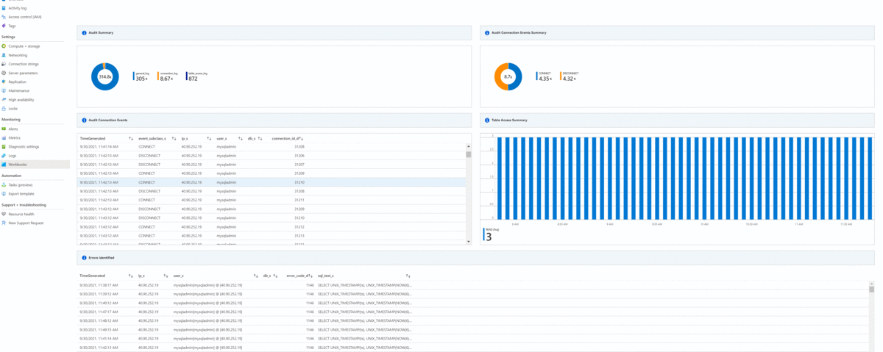
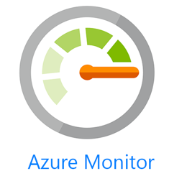
Workbooks
Flexible canvas for analyzing data and creating rich visual reports within the Azure portal.
Workbooks allow you to tap into multiple data sources across Azure and combine them into unified interactive experiences.
Workbook templates serve as curated reports that are designed for flexible reuse by multiple users and teams.
We currently have three templates:
Overview: Gives the Instance Summary and top metrics.
Auditing: Details of the Auditing events collected for the server.
Query Performance Insights: Details of instance workload
Azure Database for MySQL
Notes:
Azure Database for MySQL Flexible Server is now integrated with Azure Monitor workbooks. With workbooks, you get a flexible canvas for analyzing data and creating rich visual reports within the Azure portal. Workbooks allow you to tap into multiple data sources across Azure and combine them into unified interactive experiences. Workbook templates serve as curated reports that are designed for flexible reuse by multiple users and teams.
Monitor Azure Database for MySQL Flexible Server by using Azure Monitor workbooks | Microsoft Docs

Slide 38
Slow query logs
Configure server parameters for audit logging.
Audit Logs
audit_log_enabled, audit_log_events, audit_log_include_users, audit_log_exclude_users, audit_slow_log_enabled
Configure Diagnostics settings to specify the destination for the log files.
Access the data in Azure Monitor.
Notes:
Azure Database for MySQL Flexible Server provides users with the ability to configure audit logs. Audit logs can be used to track database-level activity including connection, admin, DDL, and DML events. These types of logs are commonly used for compliance purposes.
1, 2 & 3 are the steps to configure Audit logs
Audit logs - Azure Database for MySQL - Flexible Server | Microsoft Docs

Slide 39

Best practices for metrics - Storage
Monitor storage_used and storage_percent. Remember to configure alerting.
The server is marked read-only when the amount of free storage reaches less than 5 GB or 5% of provisioned storage, whichever is less.
The storage provisioned is used for database data and logs.
Scale up storage size before hitting the limit. The service allows you to increase storage elastically with no application impact.
Notes:
Monitor storage_used and storage_percent. Remember to configure alerting.
The server is marked read-only when the amount of free storage reaches less than 5 GB or 5% of provisioned storage, whichever is less.
The storage provisioned is used for database data and logs.
Scale up storage size before hitting the limit. The service allows you to increase storage elastically with no application impact.

Slide 40
Best practices for metrics - Storage (cont.)
Monitor io_percent and remember to configure alerting.
Azure Database for MySQL – Flexible Server supports the provisioning of additional IOPs above the complimentary IOPs limit.
Complimentary IOPs are equal to MINIMUM("Max uncached disk throughput: IOPS/MBps" of compute size, 300 + storage provisioned in GiB * 3)
Minimum IOPs is 360 across all compute sizes
Maximum IOPs is determined by the selected compute size. Max – 20000 IOPS
io_percent at 100% would cause excessive throttling, impacting database performance.
Evaluate/tune indexes and queries as necessary.
Notes:
Monitor io_percent and remember to configure alerting.
Azure Database for MySQL – Flexible Server supports the provisioning of additional IOPs above the complimentary IOPs limit.
Complimentary IOPs are equal to MINIMUM("Max uncached disk throughput: IOPS/MBps" of compute size, 300 + storage provisioned in GiB * 3)
Minimum IOPs is 360 across all compute sizes
Maximum IOPs is determined by the selected compute size. Max – 20000 IOPS
io_percent at 100% would cause excessive throttling, impacting database performance.
Evaluate/tune indexes and queries as necessary.

Slide 41

Best practices for metrics - Memory
Monitor cpu_percent and memory_percent, and remember to configure alerting.
Memory usage should be mostly consistent at steady state.
Key drivers for excessive memory usage are number of connections, or non-optimal query execution.
Opening and closing connections may drive excessive CPU usage. Consider using connection pooling.
Scale up compute before hitting the limit. The service allows you to dynamically scale compute up or down. Memory scales per vCore and consider using Business Critical tier for better price/performance.
High CPU usage is not the only indicator of CPU bottleneck. Watch out for those single threaded jobs!
Notes:
Monitor cpu_percent and memory_percent, and remember to configure alerting.
Memory usage should be mostly consistent at steady state.
Key drivers for excessive memory usage are number of connections, or non-optimal query execution.
Opening and closing connections may drive excessive CPU usage. Consider using connection pooling.
Scale up compute before hitting the limit. The service allows you to dynamically scale compute up or down. Memory scales per vCore and consider using Business Critical tier for better price/performance.
High CPU usage is not the only indicator of CPU bottleneck. Watch out for those single threaded jobs!

Slide 42

Best practices for metrics - Networking
Monitor network latency between application VM and the database. Measure with SELECT 1 tests from the client.
Average network latency should be < 2ms
Ensure application and database server are in the same region/zone
Configure VM (hosting the application) with accelerated networking
Notes:
Monitor network latency between application VM and the database. Measure with SELECT 1 tests from the client.
Average network latency should be < 2ms
Ensure application and database server are in the same region/zone
Configure VM (hosting the application) with accelerated networking

Slide 43
High availability and business continuity

Slide 44
High Availability Flexible Server
When high availability is configured, Flexible Server automatically provisions and manages a standby replica.
Zero data loss in the event of a planned or unplanned failover.
Automatic failure detection and failovers using internal monitoring mechanisms.
High uptime during planned and unplanned outages.
Two high availability architectural models:
Same-zone HA
Zone-redundant HA
Same-zone HA
Region 1
Primary
(AZ-1)
Standby
(AZ-1)
Zone-redundant HA
Region 1
Primary
(AZ-1)
Standby
(AZ-2)
Notes:
Azure Database for MySQL Flexible Server allows configuring high availability with automatic failover. The high availability solution is designed to ensure that committed data is never lost due to failures, and improve overall uptime for your application. When high availability is configured, flexible server automatically provisions and manages a standby replica. You're billed for the provisioned compute and storage for both the primary and secondary replica.
Zone-redundant HA. This option is preferred for complete isolation and redundancy of infrastructure across multiple availability zones.
Same-zone HA. This option is preferred for infrastructure redundancy with lower network latency because the primary and standby servers will be in the same availability zo
For more details :Zone-redundant HA with Azure Database for MySQL - Flexible Server | Microsoft Docs

Slide 45

Flexible Server Zone-redundant HA architecture
Region – 1
Availability Zone 1
5
Availability Zone 2
Flexible Server (Primary)
Flexible Server (Standby)
Linux VM
Linux VM
Azure VM
Synchronous Replication
Azure VM
3
4
Log replay
AKS
1
2
AKS
Premium Storage (ZRS)
Premium Storage (ZRS)
Data, binlog
Data, binlog
App Service
App Service
Daily data backups
Zone-redundant backup storage
Log flush on commit
Synchronous storage replication
Read binlog
Log replay
Automatic failover
1
2
3
4
5

Slide 46
Flexible Server Zone-redundant HA architecture
Region – 1
Availability Zone 1
5
Flexible Server (Primary)
Flexible Server (Standby)
Linux VM
Linux VM
Azure VM
Synchronous Replication
Azure VM
3
4
Log replay
AKS
1
2
AKS
Premium Storage (ZRS)
Premium Storage (ZRS)
Data, binlog
Data, binlog
App Service
App Service
Daily data backups
Zone-redundant backup storage
Log flush on commit
Synchronous storage replication
Read binlog
Log replay
Automatic failover
1
2
3
4
5

Slide 47
Failover
RTO – 60-120 Sec RPO - 0
Planned Downtime: Forced Failover
Ability to manually force a failover.
Allows you to test functionality with your application scenarios and helps prepare you for outages.
Unplanned Downtime: Automatic Failover
Unplanned service downtime has many causes, including software bugs; infrastructure faults such as compute, network, or storage failures; or power outages that affect the availability of the database.
Automatic failover to secondary server.
Notes:
If there's a failure, the time needed for the standby replica to take over the role of primary depends on the binary log application on the standby. So we recommend that you use primary keys on all tables to reduce failover time. Failover times are typically between 60 and 120 seconds.
Azure Database for MySQL - Flexible Server forced failover enables you to manually force a failover. This capability allows you to test the functionality with your application scenarios and helps make you ready for outages.
Unplanned service downtime can be caused by software bugs or infrastructure faults like compute, network, or storage failures, or power outages that affect the availability of the database. If the database becomes unavailable, replication to the standby replica is severed and the standby replica is activated as the primary database. DNS is updated, and clients reconnect to the database server and resume their operations.

Slide 48
Disaster recovery – protection from regional failures
North America (regional pair)
East US
West US
Geo-redundant backup / restore
DR across geo-paired region
Data-in Replication - based DR
Low-cost DR
On-demand DR instance creation
Lower RTO/RPO
MySQL Native Replication restrictions apply
Replicate to the same or any region
Customer managed
Higher RTO/RPO
AZ1
AZ2
AZ1
AZ2
AZ3
AZ3
Canada Central
AZ1
AZ2
To any region (replication)
AZ3
Notes:
While it's a rare event, if you want to recover from a region-level failure, you can perform database recovery by creating a new server using the latest geo-redundant backup available under the same subscription to get to the latest data. A new flexible server will be deployed to the selected region. The time taken to restore depends on the previous backup and the number of transaction logs to recover. RPO in most cases would be <15 mins and RTO would vary.
You can also use the data-in replication feature to replicate the data to another flexible server in the other region using MySQL Native replication and in the event of down time can stop the replication and use the server. For more details on data in replication
Data-in replication - Azure Database for MySQL Flexible | Microsoft Docs

Slide 49

Geo-Redundant Backup overview
Geo-Redundant backups
16 9s durability of objects.
Backup storage used for a geo-redundant server is twice that of a locally redundant server.
Geo-redundancy can be enabled for locally redundant backup storage servers after the server-create.
Currently only create-time experience for HA enabled servers.
Geo-Backup
Backup to geo-paired region.
Delay could be up to 1 hr (RPO).
Geo-Restore
On-demand restore from the latest geo-backup at the paired region.
RPO with up to one hour of potential data loss.
DB
DB
West US
East US
Notes:
Geo-Redundant backups
16 9s durability of objects.
Backup storage used for a geo-redundant server is twice that of a locally redundant server.
Geo-redundancy can be enabled for locally redundant backup storage servers after the server-create.
Currently only create-time experience for HA enabled servers.
Geo-Backup
Backup to geo-paired region.
Delay could be up to 1 hr (RPO).
Geo-Restore
On-demand restore from the latest geo-backup at the paired region.
RPO with up to one hour of potential data loss.

Slide 50
Geo-Redundant Backup workflow
Region – East US
Geo-paired Region – West US
Region – East US
Geo-paired Region – West US
Flexible Server (DR)
Flexible Server (Prod)
Flexible Server (DR)
Flexible Server (Prod)
Linux VM
MySQL
Azure VM
MySQL
Azure VM
Azure VM
MySQL
Azure VM
MySQL
AKS
AKS
AKS
AKS
Premium Storage
Storage
Storage
Storage
Backup
Data, Logs
Data, WAL
Data, WAL
Data, Logs
App Service
App Service
App Service
App Service
2
2
1
On-Demand Restore from latest backup
Geo-redundant backup storage
On-Demand Restore
Daily data backup and log backup (with RPO = 1 hour)
Geo-redundant backup storage
1
Paired region DR
Notes:
In event of a regional failure, enabling geo-redundancy for your flexible server ensures that you active server can be restored on-demand to the geo-paired region using the server's geo-backup. Geo-restore utilizes the most recent backup of the server. There is a delay between when a backup is taken and when it is replicated to different region. This delay can be up to an hour, so, if a disaster occurs, there can be up to one hour data loss.

Slide 51

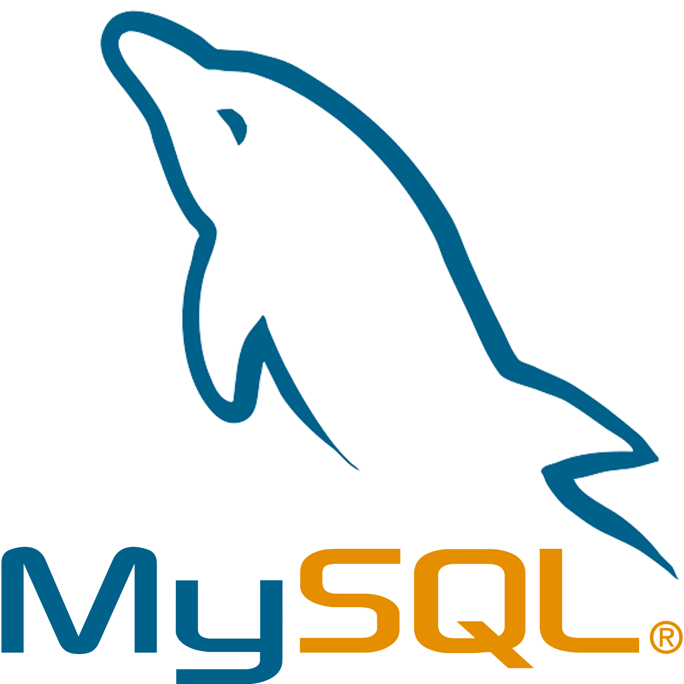

Data-in replication
Source
Replica
Azure
Azure
Synchronize data from MySQL servers to Azure Database for MySQL Flexible Server
The source MySQL server can be on-premises, in virtual machines, another Azure Database for MySQL server, or hosted in a database service from other cloud providers.
Data-in Replication is based on the binary log (binlog) file position.
Replication is managed by the customer.
Notes:
Data-in replication allows you to synchronize data from an external MySQL server into the Azure Database for MySQL Flexible service. The external server can be on-premises, in virtual machines, Azure Database for MySQL Single Server, or a database service hosted by other cloud providers. Data-in replication is based on the binary log (binlog) file position-based.
Data-in replication - Azure Database for MySQL Flexible | Microsoft Docs

Slide 52
Migration

Slide 53



Migrating from Single Server to Flexible Server
Offline logical migration using Azure Database Migration Service
Coming soon:
Online physical migration of Single Server to Flexible Server
Pre-migration tooling in Azure Database Migration Service
Pre-migration
Discover
Assess
Migrate Schema
Migration
Offline migrations
OR
OR
Dump & Restore - Offline
Native Logical Replication - Online
Azure Database Migration Services
Migrate using custom scripts: GitHub
High speed migration using Azure Data Migration Service
Online migrations
Post-migration
Use MySQL Data-in replication along with myloader/dumper for minimum downtime
Coming soon! Physical migration using Azure Premium Files
Remediate applications
Run functional & performance tests
Optimize
Notes:
Offline migrations
- Migrate using custom scripts: GitHub
- High speed migration using Azure Data Migration Service
Online migrations
- Use MySQL Data-in replication along with myloader/dumper for minimum downtime
- Coming soon! Physical migration using Azure Premium Files

Slide 54
Migrating to Azure Database for MySQL - Flexible Server
Offline migrations with planned downtime
Shared lower cost
Physical
SaaS
Azure Data Migration Service
Import and Export using MySQL Workbench
mydumper and myloader for migrating large databases.
Migrate using mysqldump or phpMyAdmin
Migrate, compare schema and data after migrations using DbForge Studio
MySQL
Azure Database for MYSQL
IaaS
MySQL
Azure Hosted VM
Virtual
Online migrations with near-zero downtime
MySQL
VMWare or HyperV
Physical
Use Data-In replication for online migrations.
The migrations source can be from on-premises or other cloud providers
MySQL
Physical Machine
Dedicated Higher cost
Higher administration
Lower administration
Comparison of mySQL environments
Notes:
Offline migrations with planned downtime
Azure Data Migration Service
Import and Export using MySQL Workbench
mydumper and myloader for migrating large databases.
Migrate using mysqldump or phpMyAdmin
Migrate, compare schema and data after migrations using DbForge Studio
Online migrations with near-zero downtime
Use Data-In replication for online migrations.
The migrations source can be from on-premises or other cloud providers

Slide 55
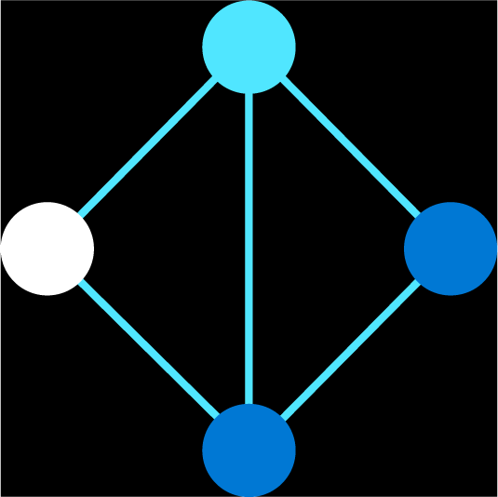
Reference architectures

Slide 56



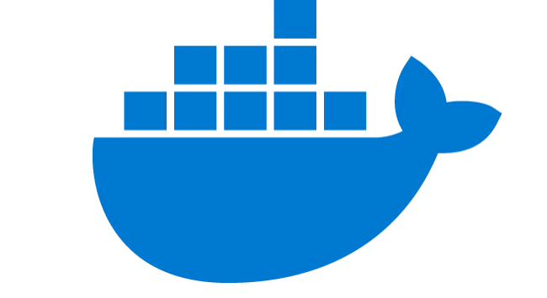

Build web apps with WordPress and Drupal
Web apps using popular CMS
Scalable Open-Source Architecture Using Azure App Service Environment
Accelerate time to market by leaving database management to Azure Database for MySQL
Run an Azure Database for MySQL server side-by-side with Azure App Service to simplify development
Integrate effortlessly with popular content management systems like WordPress, Drupal, and Joomla
Azure Database for MySQL
v
Content Delivery Network
Azure App Service
Redis Cache
Monitoring/ Logging
Users
Docker Hub
Azure Database for MySQL provides a fully managed service to store vast content as part of the Nobel Prize’s WordPress site
Notes:
Nobel Media of Stockholm, Sweden is responsible for building and maintaining the Nobel Prize website. In the minutes and hours surrounding the announcement of each Nobel Prize, traffic on the website increases 1,000- to 10,000-fold. Their website now runs the open-source WordPress content management system based on the PHP scripting language in Azure App Service, and they use Azure Database for MySQL to store the content. To make the website even more performant, they also use Azure Cache for Redis to accelerate the data layer through in-memory caching.
Azure App Service is a hosting platform for web applications, REST APIs, and mobile back ends in Azure. App Service adds the power of Azure to your application, and has features for security, load balancing, autoscaling, and automated management. It allows you to host both Linux and Windows web applications, so if you are planning to build a website using WordPress, Drupal, or Joomla as the content management system, you can deploy a new website easily using Azure Marketplace and the deployment templates.

Slide 57







Build custom microservices in the cloud with Azure Kubernetes Service
Cloud-native apps
Microservice architecture with Azure Database for MySQL and Azure Kubernetes Service
Quickly provision databases with microservices architectures and flexibly scale compute and storage independently without extra configuration
Easily integrate with Azure Kubernetes Service and other managed services to simplify deployment and improve monitoring
Azure Database for MySQL
Azure API Management
Azure Traffic Manager
Azure Kubernetes Service
Docker
Users
Azure Application Gateway
Azure Blob Storage
Danish IT company KMD can scale API services multiple times a day with Azure Database for MySQL and Azure Kubernetes Service
Notes:
Many developers and organizations deploy microservices architectures to offer resilient, scalable, and developer friendly applications. Unlike traditional monolithic apps, each microservice operates independently and can be updated without redeploying the application. Each service also manages its own persistence layer, which means that service teams can perform database schema updates without affecting other services.
While microservices apps offer major benefits, they require advanced tools and knowledge of distributed systems. Organizations utilize domain analysis to define optimal boundaries between services, and use well-defined APIs to implement communication between the services. A single small team of developers can write and maintain a microservice, and they can make independent decisions on which technology stack, libraries, or frameworks they want to use.
Since microservices communicate with each other using well-defined APIs, API management is very important. Azure API Management allows organizations to manage and securely expose their APIs hosted on diverse environments from a central service. API Management simplifies legacy API modernization, API exposure to multiple platforms, and the exchange of data between businesses. Applications call APIs through an API gateway that validates credentials, enforces quotas, serializes requests in different protocols, and more. Developers operate their API Management instances through the management plane in Azure, and they can expose API documentation for internal and external users through the Developer portal.
On Azure, organizations often deploy microservices to Azure Kubernetes Service and use CI/CD or Continuous Integration/Continuous Development platforms, such as GitHub actions. Azure Kubernetes Service provides many enterprise features, such as deployment of the application or the microservice across nodes that live in multiple Azure regions, load balancing, automatic restarts, redeployment, and more. Kubernetes apps that persist data in Azure Database for MySQL Flexible Server also get many benefits. For example, you can co-locate Flexible Server and Azure Kubernetes Service nodes in the same availability zone to minimize latency, and as a developer you will be able to manage Flexible Server instances directly from AKS using the Azure Service Operator.

Slide 58

Additional reference architecture examples
For more information about the types of reference architectures supported by Azure Database for MySQL, see the MySQL Enterprise Use Case Deck.
eCommerce and payments
Gaming
Payment and banking
Healthcare
Link: Azure Database for MySQL Enterprise Use Case Deck
Telecom
Education
CMS

Slide 59
Documentation and resources

Slide 60


Documentation and resources
Azure Database for MySQL homepage
http://aka.ms/mysql
Azure Database for MySQL pricing
Azure Database for MySQL
Azure Database for MySQL documentation
http://aka.ms/mysqldocs
Azure Database for MySQL migration partners
https://docs.microsoft.com/azure/mysql/partners-migration-mysql
Ask Questions
Ask Azure DB for MySQL
MySQL Videos
MySQL Developer Essentials MySQL Beginner Series
Azure Database for MySQL use cases deck
Azure Database for MySQL Enterprise Use Case Deck
GearUp: Open Source Databases on Azure
Notes:
Intelligent apps
Develop sophisticated, transformational apps using state-of-the-art machine-learning algorithms and integrated visualization tools for analytics and actionable insights.
Retail and e-commerce
Build highly secure and scalable e-commerce solutions that meet the demands of both consumer and business customers. Engage customers through targeted products and offers, process transactions quickly, and optimize fulfillment and customer service.
Scalable web and mobile applications
Rapidly build engaging, scalable cross-platform and native apps for iOS, Android, Windows, or Mac.
Digital marketing
Engage with customers around the world with rich, personalized digital marketing experiences. Quickly build and launch digital campaigns that automatically scale based on traffic and customer demand.
Financial management apps
Securely store critical data and provide high-value analytics and insights over aggregated data to users, using built-in security and high availability.
Gaming
Scale your databases elastically to accommodate unpredictable bursts of traffic and deliver low-latency multi-player experiences.
Pcs:
Updated text
Added Gaming

Slide 61
Thank you

